Slide 1
Genetic Variation in Populations

Slide 2
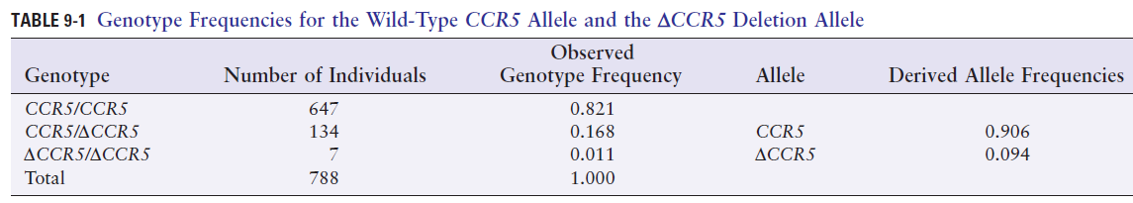
Population genetics: the quantitative study of the distribution of genetic variation in populations

Slide 3
Hardy-Weinberg law: frequency of the three genotypes AA, Aa, and aa is given by the terms of the binomial expansion of
(p+q)²=p²+2pq+q²
Hardy-Weinberg equilibrium
large population
random matings
no mutation
no selection
no immigration
The Hardy-Weinberg law with autosomal recessive disease:
PKU frequency 1 in 4500
q² = 1/4500
q = 0.015
2pq = 0.03 >>> carrier frequency 3%

Slide 4
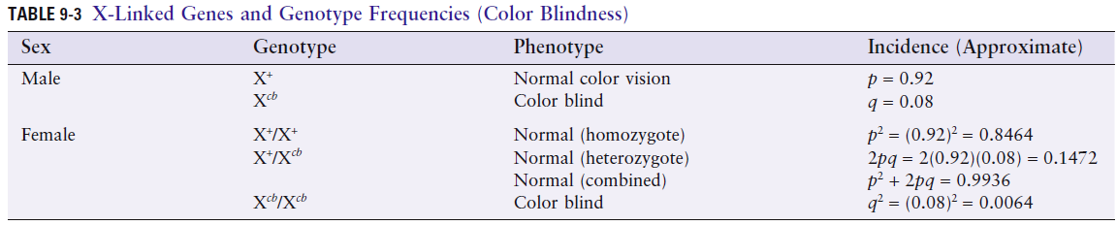

Slide 5
Factors that contribute to nonrandom mating, thus disturb HWE:
Stratification
Assortative mating
Consanguinity

Slide 6
Stratification: the presence of subgroups, genetically separate
Hypothetical situation:
Majority 90%, minority 10%
In the minority group: q_{min} allele frequency is 0.05
p_{min} allele frequency is 0.95
In the majority group: q_{maj} allele frequency is ≈ 0
p_{maj} allele frequency is ≈ 1
Overall population allele frequency q_{pop}=0.05*0.1=0.005
Frequency of disease in pop as a whole predicted q²_{pop}=(0.005)²= 2.5*10⁻⁵
Exclusive mating within the minority group will result in freq of affecteds to be q²_{min}=(0.05)²=0.0025
and for the entire pop would be 0.0025*0.1= 2.5*10⁻⁴
10 fold higher

Slide 7
Assortative mating: choice of a mate because mate possesses some particular trait.
Tend to be positive thus increasing proportion of homozygotes at the expense of heterozygotes
e.g. achondroplasia, homozygotes never seen unless both parents are affected
Mates with autosomal recessive disorders caused by allelic mutations would have all their children affected,
exception: genetic heterogeneity

Slide 8
Consanguinity increases the frequency with which carriers of an autosomal recessive disorder mate
Genetic isolates: small populations derived from a limited number of common ancestors
Tay-Sachs disease is 100 times more common in Ashkenazi Jews (1 per 3,600) than in most other populations (1 per 360,000)
Carrier frequency in Ashkenzi Jews 1 in 30 while in other 1 in 300

Slide 9
Changes in allele frequency due to mutation or selection usually occur slowly, in small increments, and cause much less deviation from HWE, at least for recessive disorders
Coefficient of selection (s) a measure of the loss of fitness
s = 1 – f
Proportion of mutant alleles that are not passed on and thus are lost as a result of selection

Slide 10
Mutation and selection balance in dominant disease
Frequency of mutant alleles represents a balance between loss of mutant alleles through selection and gain of mutant alleles through mutation
μ = sq
μ: mutation rate
s: coefficient of selection
q: allele frequency
For x-linked recessive mutations: μ = sq/3
Selection is operating only on the third of the mutant alleles in the population that are present in males

Slide 11
Genetic drift: random fluctuation of allele frequencies in small populations – Chance events can have a much greater effect on allele frequencies in a small population than in a large one
Founder Effect: One special form of genetic drift.
A high frequency of a mutant allele in a population founded by a small ancestral group when one or more of the founders was a carrier of the mutant allele
Gene flow: gradual diffusion of genes from one population to another across a barrier (physical or cultural)
Genetic admixture: genes of migrant populations with their own characteristic allele frequencies are gradually merged into the gene pool of the population into which they have migrated

Slide 12
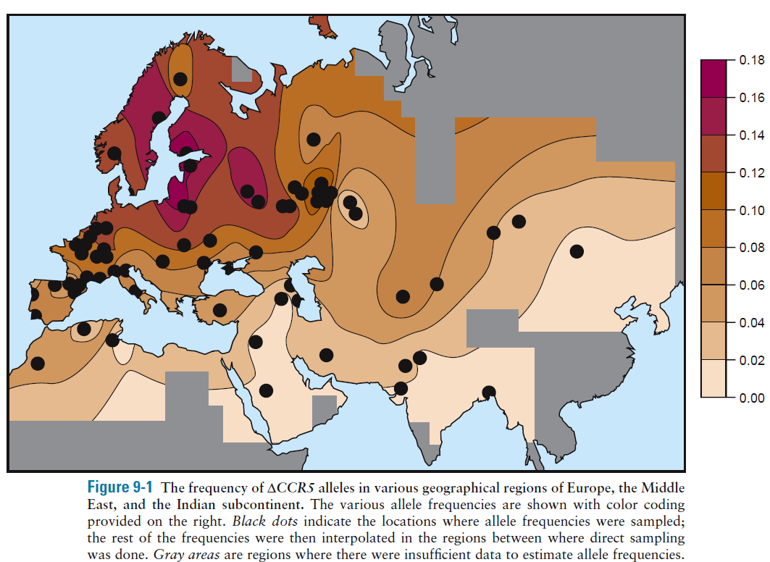
Mutation originated in northern Europe and then underwent both positive selection and gene flow over long distances

Slide 13
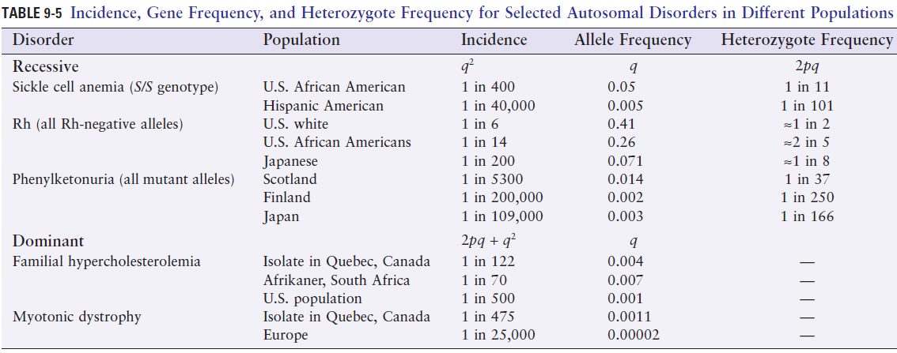
Ethnic differences in the frequency of genetic diseases
Hemolytic disease of the newborn caused by Rh incompatibility
Pregnant woman are injected by Rh immune globulin at 28-32 weeks of gestation and again after pregnancy
Rh immune globulin serves to clear any Rh-positive fetal cells from the mother’s circulation before she is sensitized

Slide 14
Founder effect
High incidence of Huntington disease in parts of Venezuela
High incidence of type I tyrosinemia in French Canadians (1 in 685, compared to 1 in 100,000 in other populations)
Positive selection for heterozygotes (heterozygote advantage)
Heterozygotes have an increased fitness not only over homozygotes for the mutant allele but even over homozygotes for the normal allele
Balanced polymorphism: a situation in which selective forces operate both to maintain a deleterious allele and to remove it from the gene pool
Malaria and sickle cell disease

Slide 15
Genetics and ancestry
Ancestry informative markers (AIMs): alleles that show large differences in allele frequency among populations originating in different parts of the world
Studies of hundreds of thousands of AIMs from across the genome have been used to distinguish and determine the genome-wide relationships among many different population groups

Slide 16
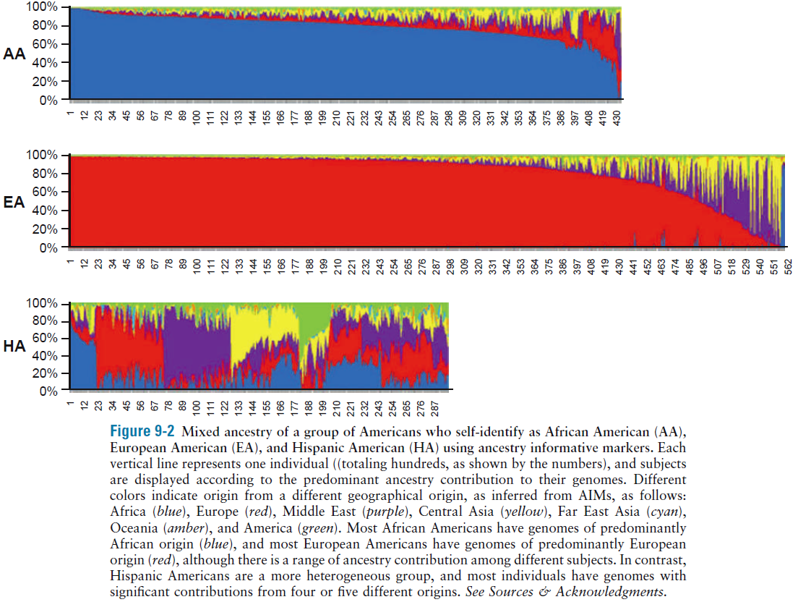
Hispanics are genetically heterogeneous with ancestors from many parts of the world

Slide 17
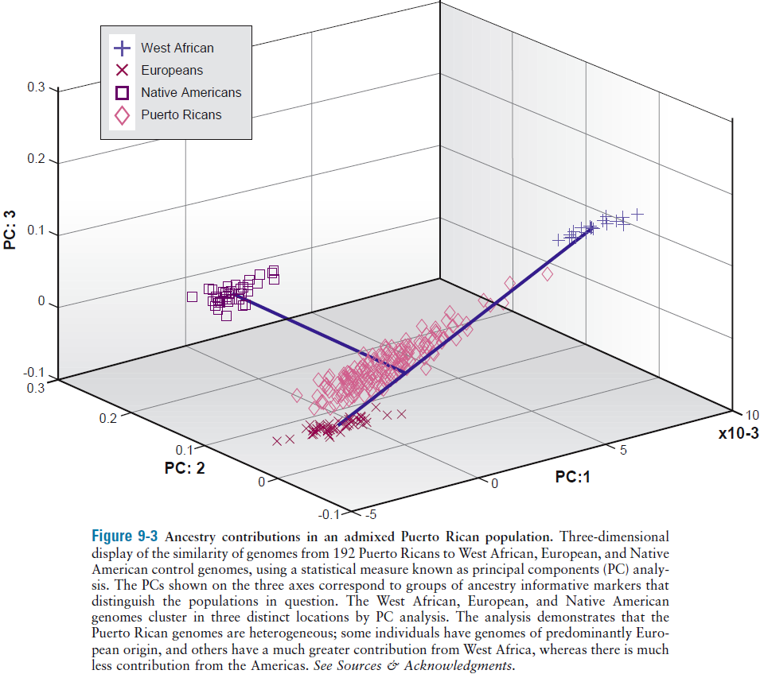

Slide 18
Population genetics and race
Race: real or fiction?

